Slide 1
RDFD: Discovering Fake Drivers Based on Temporal Driving Behaviors
Presented By: Hashim Abu-gellban, Suwaphit Buabuthr, Roshan Dhamala, and Franco Navas
R
Notes:
Roshan

Slide 2
Agenda
Introduction
Problem Definition
Motivation
Dataset
Challenges
Methodology
Results
Conclusion
Contributions
References
Demo
R
Notes:
Roshan

Slide 3
Introduction
This project discusses the driver identification technology which uses several machine learning methods to discover fake drivers.
The growth of ride-sharing services (e.g., Uber and Lyft) in the taxi industry has raised the necessity of a stable driver identification model to classify the human subjects behind the wheels (i.e., fake Uber drivers).
Several drivers in these services attempted to manipulate the system to get more bonuses through having several accounts.
E.g., some Uber drivers in China signed up with several Uber accounts to increase their bonuses as mentioned in an article in Quartz[1].
Moreover, vehicle theft incidents have occurred frequently in recent years despite embedded vehicle security software.
R
Notes:
Roshan

Slide 4
Introduction
The existing solutions such as GPS tracking is implemented to prevent vehicle theft however it has not become an ideal solution to mitigate the problem and it may be considered by some drivers as an invasion of privacy.
An automatic driver classification model using machine learning techniques can help to address this problem. Also, the driver classification models can be used to detect burglary that may positively impact millions of vehicle owners.
To address this issue, we adopt machine learning with the aim to infer behavioral characteristics to discriminate between different drivers from a set of vehicle-related features.
The main idea behind the proposed method is represented by exploring different driving indicators (e.g. fuel consumption, Torque of friction,engine temperature) that focus on the driver’s driving pattern (style).
R
Notes:
Roshan

Slide 5
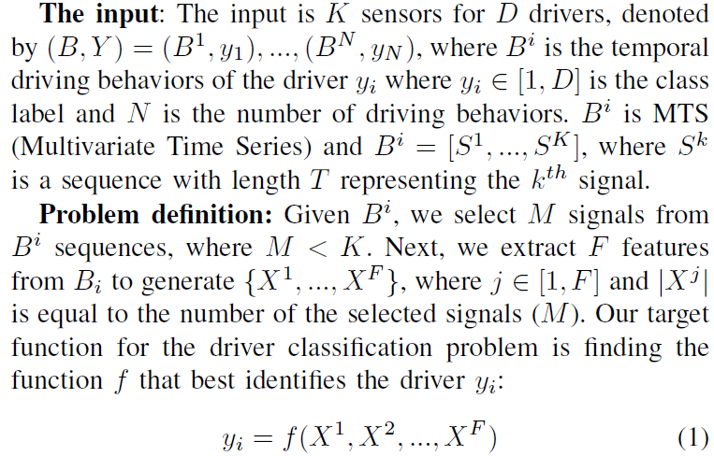
Problem Definition
H
Notes:
Roshan

Slide 6
Motivation
The exploration of the driver’s driving pattern could be an effective approach to detect fake drivers and prevent vehicle theft.
Drivers exhibit different driving patterns. These driving patterns can serve as an appropriate indicator for driver authentication.
Our method will ensure to recognize the real driver of a car using a set of characteristics from the analysis of the different driving sensors from the dataset.
R
Notes:
Roshan

Slide 7
Dataset
We used the public dataset containing 51 sensors from the real driving of a KIA car. It has 10 drivers who have driven the car for 23 hours. The sensors were extracted from the OBD-II (On-Board Diagnostics-II) port.
The ten drivers, labeled from “A” to “J”.
The data that we have used has total of 94,380 items recorded every second with a size of 16.9Mb in total.
R
Notes:
Roshan

Slide 8
Dataset
'data.frame': 94380 obs. of 54 variables:
$ Fuel_consumption : num 269 243 218 205 218 ...
$ Accelerator_Pedal_value : num 0 0 0 0 0 0 0 0 0 0 ...
$ Throttle_position_signal : num 5.2 6.1 5.2 4.7 5.7 5.7 5.7 6.6 7.1 7.1 ...
$ Short_Term_Fuel_Trim_Bank1 : num 0 0 0 0 0 0 0 0 0 0.8 ...
$ Intake_air_pressure : int 33 40 41 38 40 41 42 52 60 65 ...
$ Filtered_Accelerator_Pedal_value : int 0 0 0 0 0 0 0 0 0 0 ...
$ Absolute_throttle_position : num 13.3 13.7 13.7 13.3 13.7 13.7 13.7 14.5 14.5 14.9 ...
$ Engine_soacking_time : int 3 3 3 3 3 3 3 3 3 3 ...
$ Inhibition_of_engine_fuel_cut_off : int 0 0 0 0 0 0 0 0 0 0 ...
$ Engine_in_fuel_cut_off : int 0 0 0 0 0 0 0 0 0 0 ...
$ Fuel_Pressure : int 0 0 0 0 0 0 0 0 0 0 ...
$ Long_Term_Fuel_Trim_Bank1 : num -0.8 -0.8 -0.8 -0.8 -0.8 -0.8 -0.8 -0.8 -0.8 -0.8 ...
$ Engine_speed : int 929 726 685 675 716 740 682 670 655 648 ...
$ Engine_torque_after_correction : num 5.5 7 7 7 8.2 9 11.7 16.8 21.5 23.8 ...
$ Torque_of_friction : num 9 7.8 7.4 6.6 11.3 16 16.4 18 18.8 19.5 ......
....
....
....
R
Notes:
Roshan

Slide 9
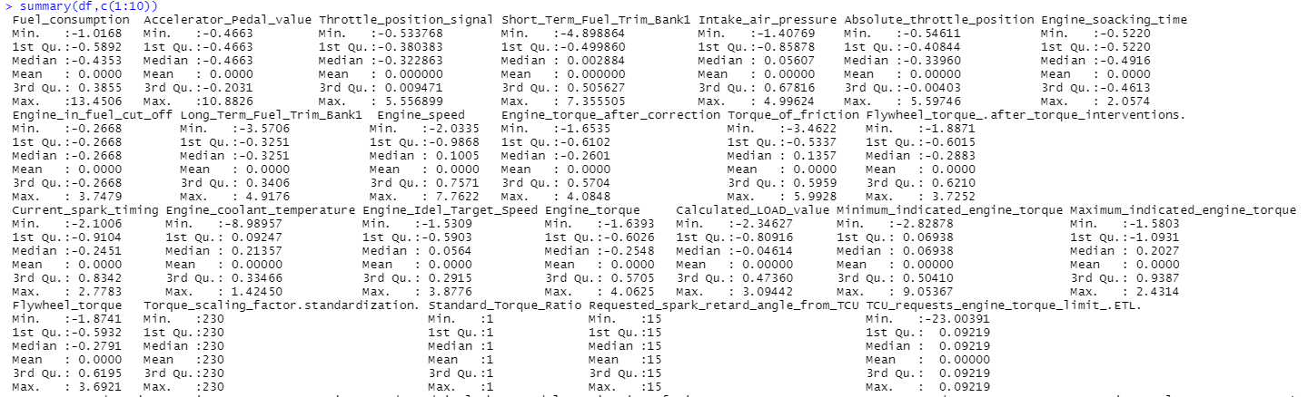
Normalized Data
R
Notes:
Roshan

Slide 10
Challenges
Signal noise
Multi-class problem (2 to 10 Action Space where some previous research faced unpleasant results when the researcher increased the number of drivers from 2 to 3, 4 & 5)
High dimensionality (Large State Space)
Multivariate time series
Segmentation
Set of Feature Generation (FG) approaches
Reducing the number of selected features generated by (FG)
High-performance classification model
H
Notes:
Hashim

Slide 11
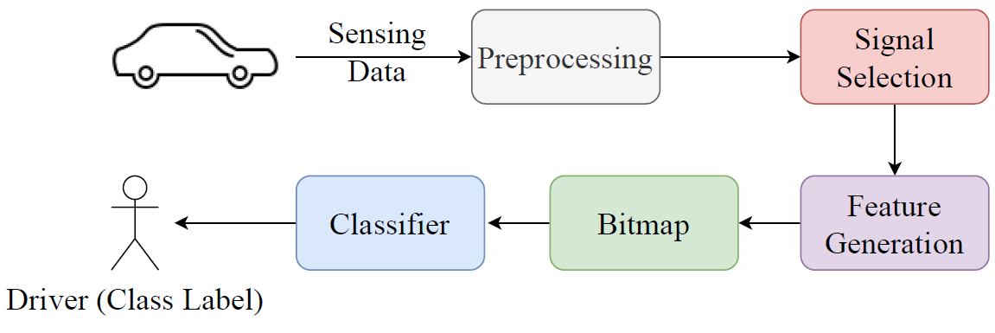
Methodology
Preprocessing
Signal Selection
Feature Generation & Bitmap
Classification
H
Notes:
Hashim

Slide 12
Methodology
Preprocessing
Data cleaning was done to avoid irrelevant and missing data parts.
Removed few columns(8 signals) which has 0 value in all the rows.
Drop “Time” attribute
Convert class labels to factors.
Performed normalization in order to scale the data values in a specified range. All the numerical variables have been standardized between 0 and 1.
H
Notes:
Hashim

Slide 13
Methodology
Signal Selection
Selected 11 signals from 51 signals that are most relevant and important for our model.
Evaluated variable importance using Random Forest
Signal segmentation: 10, 20, 30, 60 seconds
Feature Generation
Used FTT(Fast Fourier Transform) to reduce noise.
Temporal Segment Splitting, to enhance performance.
Generated 6 features for each sub-signal: (Mean, SD, Min, Median, Max, Kurtosis, Skewness, Kurtosis of signal differences, Skewness of signal differences)
Dropped highly correlated features to reduce the dimensionality of input size (e.g., 132 to 30)
Bitmap: Scaling data between 0 and 1
H
Notes:
Hashim

Slide 14
Methodology
Partitioned generated data into 20% of the testing dataset and 80% of the training dataset.
Classification:
CTree
SVM
Random Forest
KNN (3, 5, 7, Sqrt(n))
H
Notes:
Hashim

Slide 15
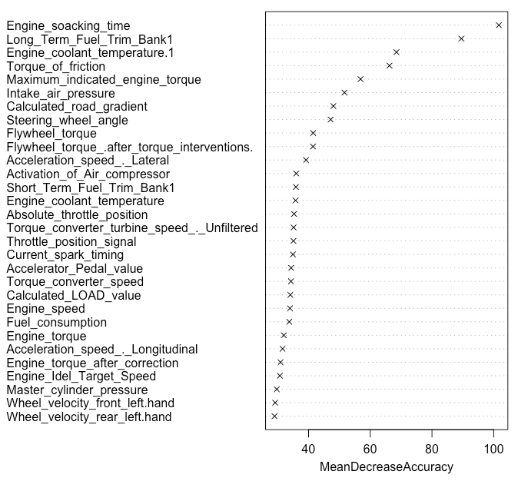
Evaluated variable importance using random forest
R
Notes:
Roshan

Slide 16
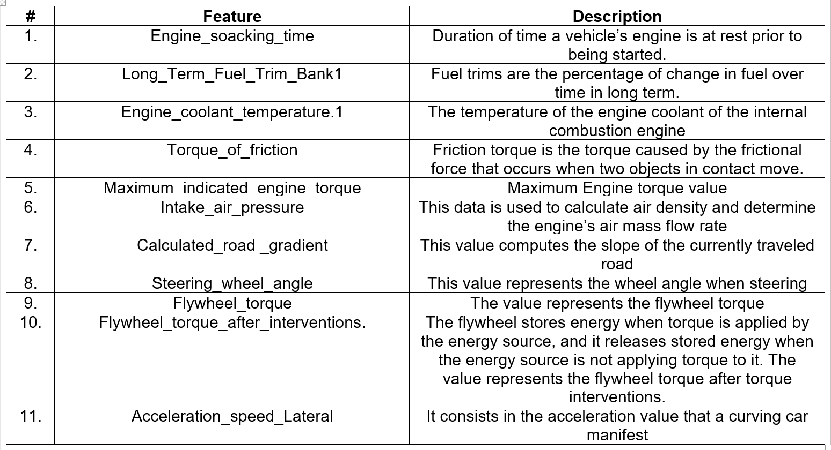
Top 11 Signals after feature selection
R
Notes:
Roshan

Slide 17
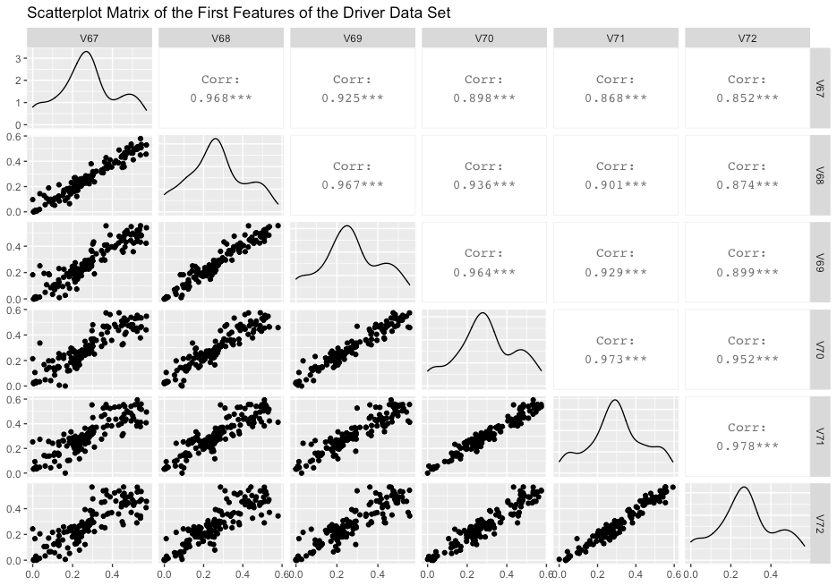
Results - Overall Results
Algorithm | Accuracy | Precision | Recall | F1-score
Ctree | 0.93 | 0.93 | 0.93 | 0.93
SVM | 0.98 | 0.97 | 0.97 | 0.97
Random Forest | 0.97 | 0.97 | 0.97 | 0.97
KNN(3) | 0.92 | 0.93 | 0.92 | 0.92
Parameters
- W = 2
- #Driver = 10
- Segmentation = 10
Median of second part of signals, where signals splitted into 2
H
Notes:
Hashim

Slide 18
Parameters
- W = 2
- #Driver = 10
- Segmentation = 10
V68: Skewness of signal 2
V67: Skewness of signal 1
S
Notes:
Suwaphit

Slide 19
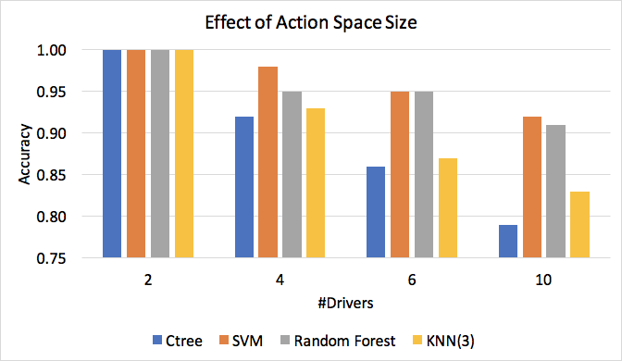
Results - The Effect of Increasing the Action Space
Parameters
- W = 1
- #Drivers =
2, 4, 6, 10
- Segmentation = 10
H
Notes:
Hashim

Slide 20
Parameters
- W = 1
- #Drivers =
2, 4, 6, 10
- Segmentation = 10
S
Notes:
Suwaphit

Slide 21
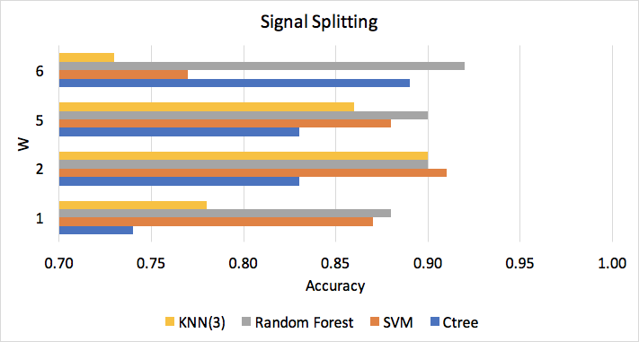
Results - The Effect of Segmentation Splitting
Parameters
- W = 1, 2, 5, 6
- #Drivers = 10
- Segmentation = 30
H
Notes:
Hashim

Slide 22
Parameters
- W = 1, 2, 5, 6
- #Drivers = 10
- Segmentation = 30
S
Notes:
Suwaphit

Slide 23
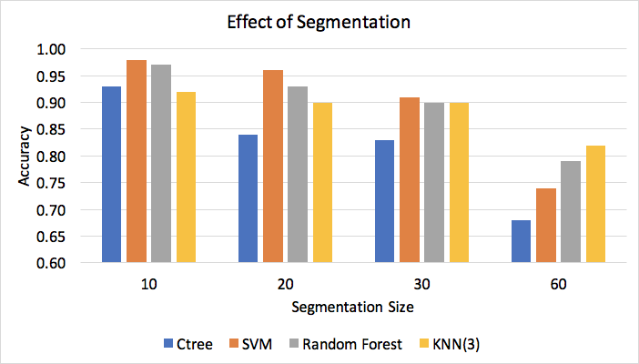
Results - The Effect of Segmentation
Parameters
- W = 2
- #Drivers = 10
- Segmentation =
10, 20, 30, 60 seconds
H
Notes:
Hashim

Slide 24
Parameters
- W = 2
- #Drivers = 10
- Segmentation =
10, 20, 30, 60
S
Notes:
Suwaphit

Slide 25
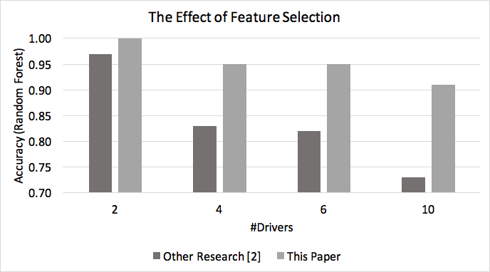
Results - Using 15 Signals from Previous Research
Parameters
- W = 1
- #Drivers =
2, 4, 6, 10
- Segmentation = 10
- Random Forest Classifier
H
Notes:
Hashim

Slide 26
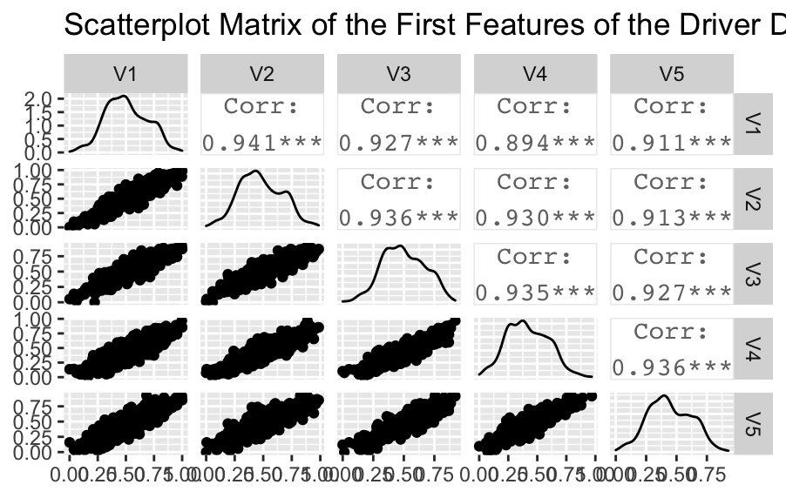
Results - The 14 Signals from Previous Research
Long Term Fuel Trim Bank1
Intake Air Pressure
Accelerator Pedal Value
Fuel Consumption
Torque of Friction
Maximum Indicated Engine Torque
Engine Torque
Calculated LOAD Value
Activation of Air Compressor
Engine Coolant Temperature
#"Transmission Oil Temperature" #not found in the dataset
Wheel Velocity Front Left Hand
Wheel Velocity Front Right Hand
Wheel Velocity Rear Left Hand
Torque Converter Speed
Mean of the first 5 signals
Note: The blue texts of the signals indicate that the signals have been used in our approach. We could not find the Transmission Oil Temperature in the dataset.
H
Notes:
Hashim

Slide 27
Conclusion
We worked on addressing the fake driver problem focusing on tackling the cold start problem.
We employed a set of efficient machine learning algorithms to address the challenges and to improve the accuracy (RF: > 90% for 2, 4, 6, 10 drivers and W=1 and 2)
Reducing state space size: Signal Selection, Feature Selection( dropping highly correlated features > 0.99).
Splitting Segmentations (W).
The SVM and the Random Forest classifiers gave the best results in general, while SVM was more sensitive to W (segment splitting).
H
Notes:
Hashim

Slide 28
Contributions
Hashim Abu-gellban: Normalization, Finding/ Dropping Zero Signals, Temporal Segmentation, Handling Imbalanced dataset, Signal Transformation, Feature Generation (FG), Bitmap (Normalization), Finding/ Dropping highly Correlated Features Generated by FG, Classification, Plotting Features, Results.
Suwaphit Buabuthr : Result, Visualization, Demo
Roshan Dhamala: Dataset presentation, Signal Selection
Franco Navas: planned to drop the course
S
Notes:
Suwaphit

Slide 29
References
[1] https://qz.com/423288/fake-drivers-and-passengers-are-boosting-ubersgrowth-in-china/
[2] Kwak, B. I., Woo, J., & Kim, H. K. (2016, December). Know your master: Driver profiling-based anti-theft method. In 2016 14th Annual Conference on Privacy, Security and Trust (PST) (pp. 211-218). IEEE.
S
Notes:
Suwaphit

Slide 30
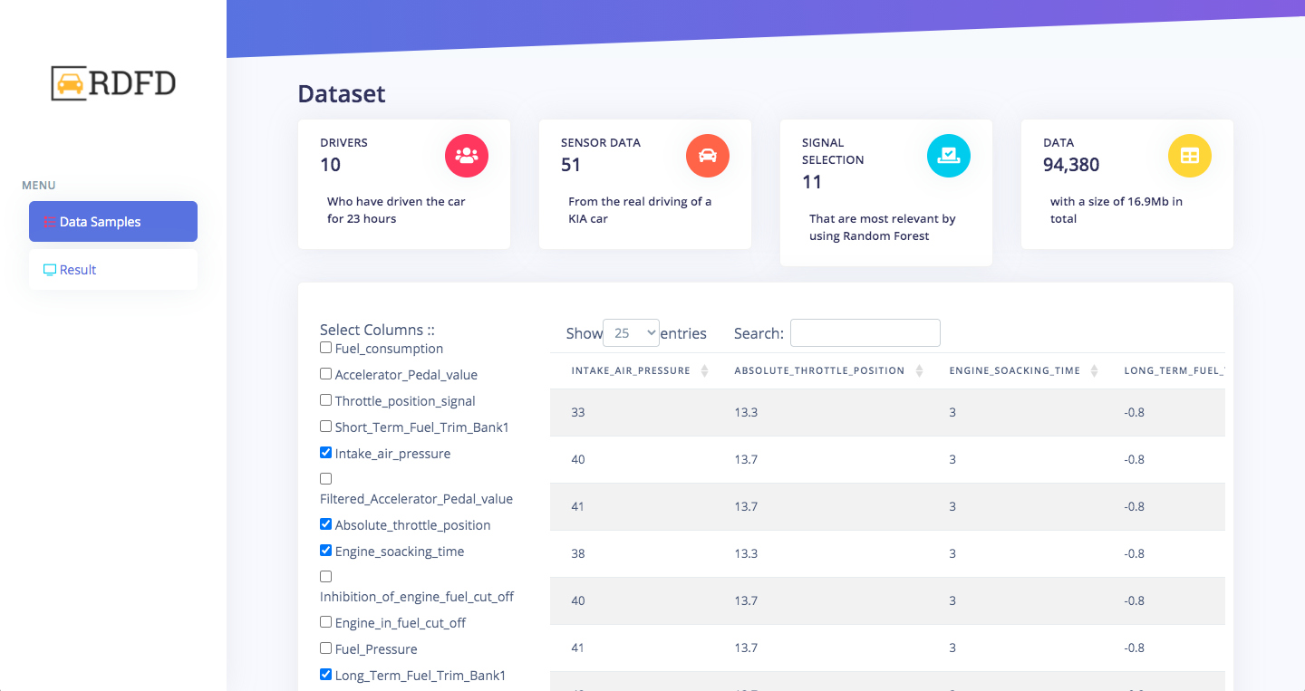
Demo
S
Notes:
Suwaphit

